Slide 1
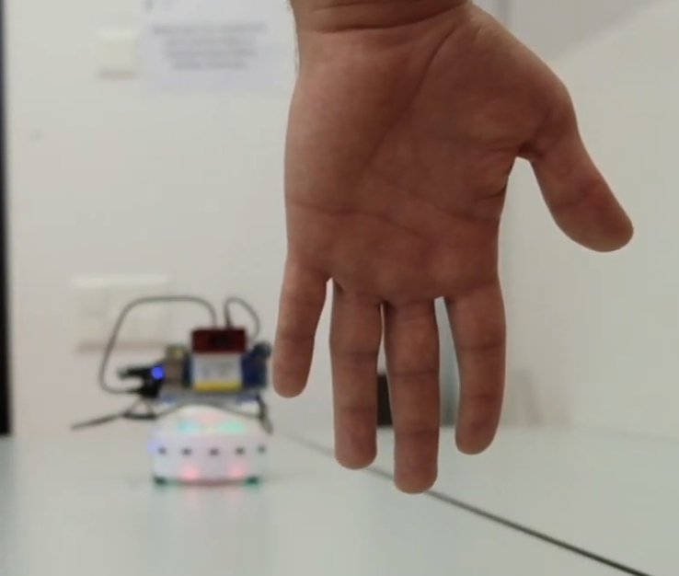
Hand-based human-robot interaction
USI
Robotics
Weimeng Pu
Reinard Lazuardi Kuwandy
Amirehsan Davoodi
27th May 2019

Slide 2

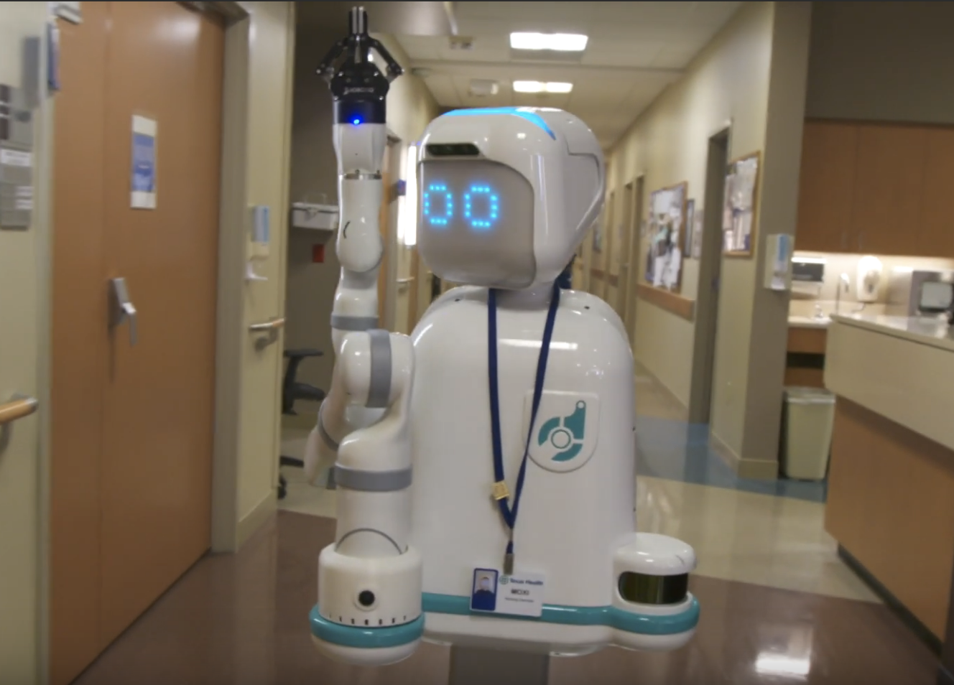

Introductions:
Hand detection and tracking:
Computer Vision
System control
Real-life experiment
Notes:
Hand detection and tracking is a multi disciplinary problem which includes:
Computer Vision and specifically Convolutional Neural Network.
System control
Real-life experiments and applications.
Here are only two real robot assistant that are used.
On the top, we have Moxi Robot which is an assistant in an hospital
At bottom, you can also see an image of the robots Jeno and Jena which giving room services in a Singapore hotel.
Both of these examples and many more require vision to interact to the environment.

Slide 3
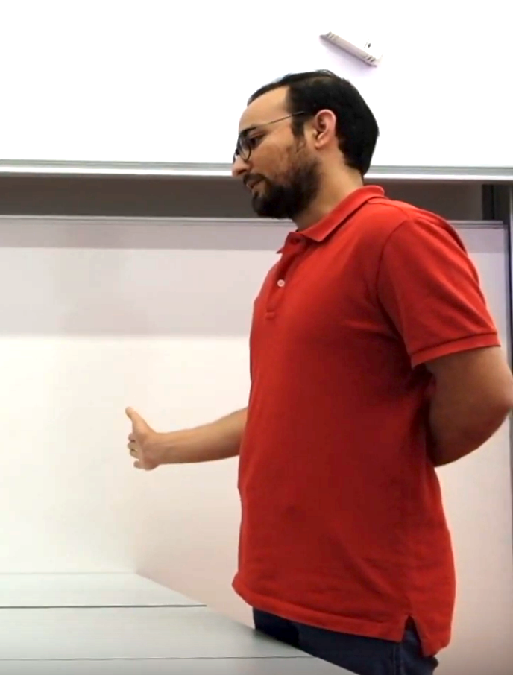
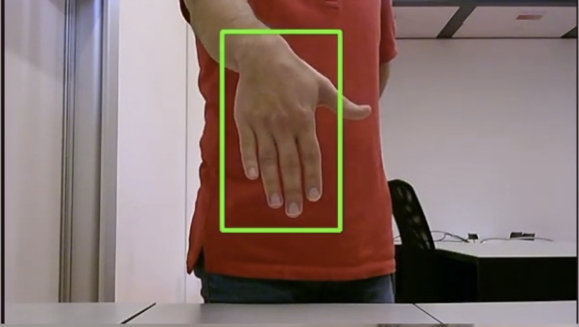
How our system works?
}
Confidence: 0.96
Offset: -16.72
Human robot
interaction
Control
Tricks
ssd mobilenet v1

Slide 4
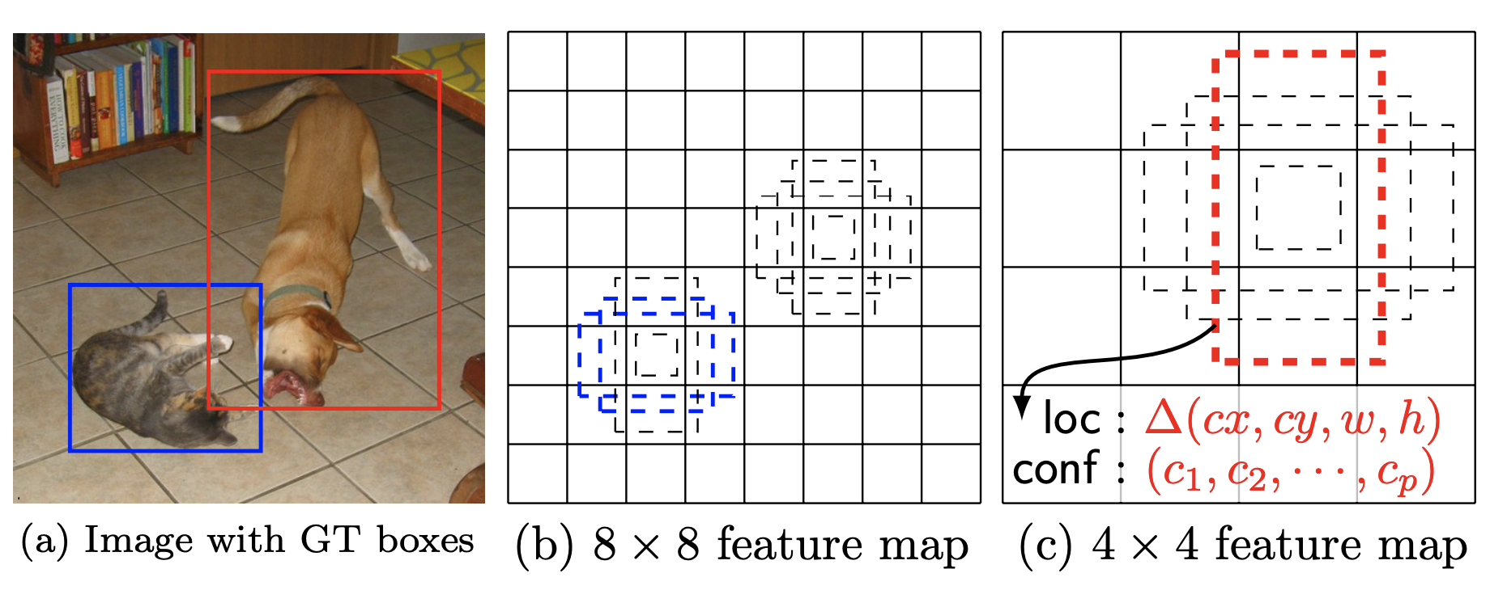
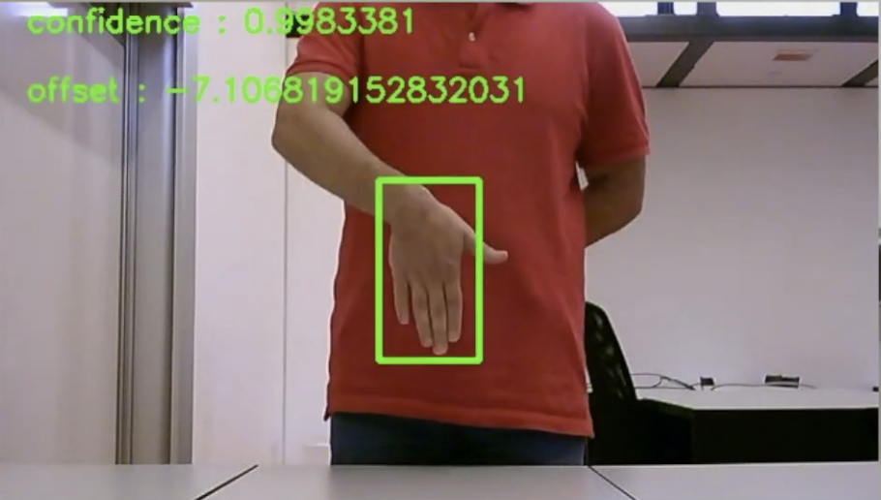
How our system works?
SSD mobilenet Framework:
The model loss:
weighted sum between localization loss and confidence loss
Train:
input images
ground truth boxes
Predict
shape offsets
confidences
?
Notes:
SSD framework. (a) SSD only needs an input image and ground truth boxes for each object during training. In a convolutional fashion, we evaluate a small set (e.g. 4) of default boxes of different aspect ratios at each location in several feature maps with different scales (e.g. 8 × 8 and 4 × 4 in (b) and (c)). For each default box, we predict both the shape offsets and the confidences for all object categories ((c1, c2, · · · , cp)). At training time, we first match these default boxes to the ground truth boxes. For example, we have matched two default boxes with the cat and one with the dog, which are treated as positives and the rest as negatives. The model loss is a weighted sum between localization loss (e.g. Smooth L1 [6]) and confidence loss (e.g. Softmax).

Slide 5
How our system works?
Dataset:
EgoHands: A Dataset for Hands in Complex Egocentric Interactions
Contains:
48 different videos of egocentric interactions with pixel-level ground-truth annotations for 4,800 frames and more than 15,000 hands!

Slide 6
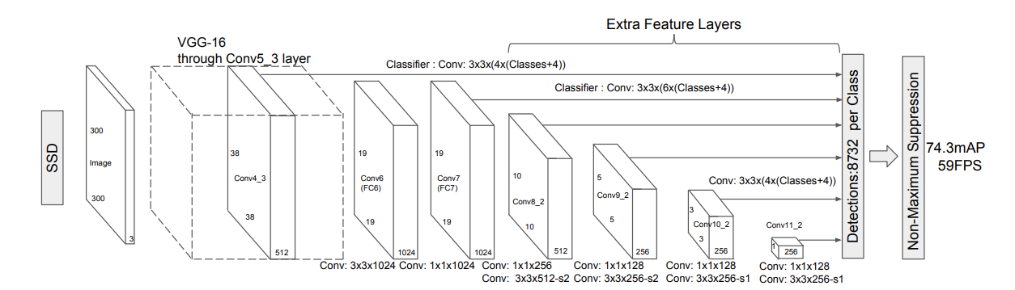
How our system works:
Architecture:
Extra feature layers help to predict:
offsets to default boxes of different scales and aspect ratios
Associated confidences
single shot detection (SSD) model architecture

Slide 7
Results:
lets watch it.
3:14 min

Slide 8
Github & Video Links
https://github.com/nutintin/Robotic_SP2019 (github)
https://www.youtube.com/watch?v=087OmK-mPvQ (video)

Slide 9
Acknowledgments
https://github.com/victordibia/handtracking - handtracking
https://github.com/jeguzzi/mighty-thymio - mighty thymio
https://github.com/FrancescoSaverioZuppichini/Robotics-Final-Project - object detection with mighty thymio
https://github.com/Mirko-Nava/Learning-Long-range-Perception - Learning Long-range Perception using Self-Supervision from Short-Range Sensors and Odometry
https://arxiv.org/pdf/1512.02325.pdf - SSD: Single Shot MultiBox Detector (paper)

Slide 10
Thank you

Slide 11
One is to compute the Euclidian distance between the center of the two bounding boxes. Because hands shouldn’t go too far in between frames. Also for the same reason, the width of the two boxes shouldn’t vary too much
Having enough with camera, do not forget our old friend, proximity sensors. Our Thymio is also able to stop before reaching an obstacle. Backing up itself and with the guidance of the hand, it will eventually find its way out. However, as always, there would be delay in transmitting information between laptop and robot. Such as in the basketball case, our robot did not even notice the ball coming from the side.

Slide 12
How about fake hand, surprisingly our thymio can still be tricked by hand image.
Our Thymio is curious about the outside world, lets introduce it to the place we study and live.
Here we are you can see that it is working perfectly.
We are done for this small project but our friends can be improved for better Human-robot interaction.

